Slide 1

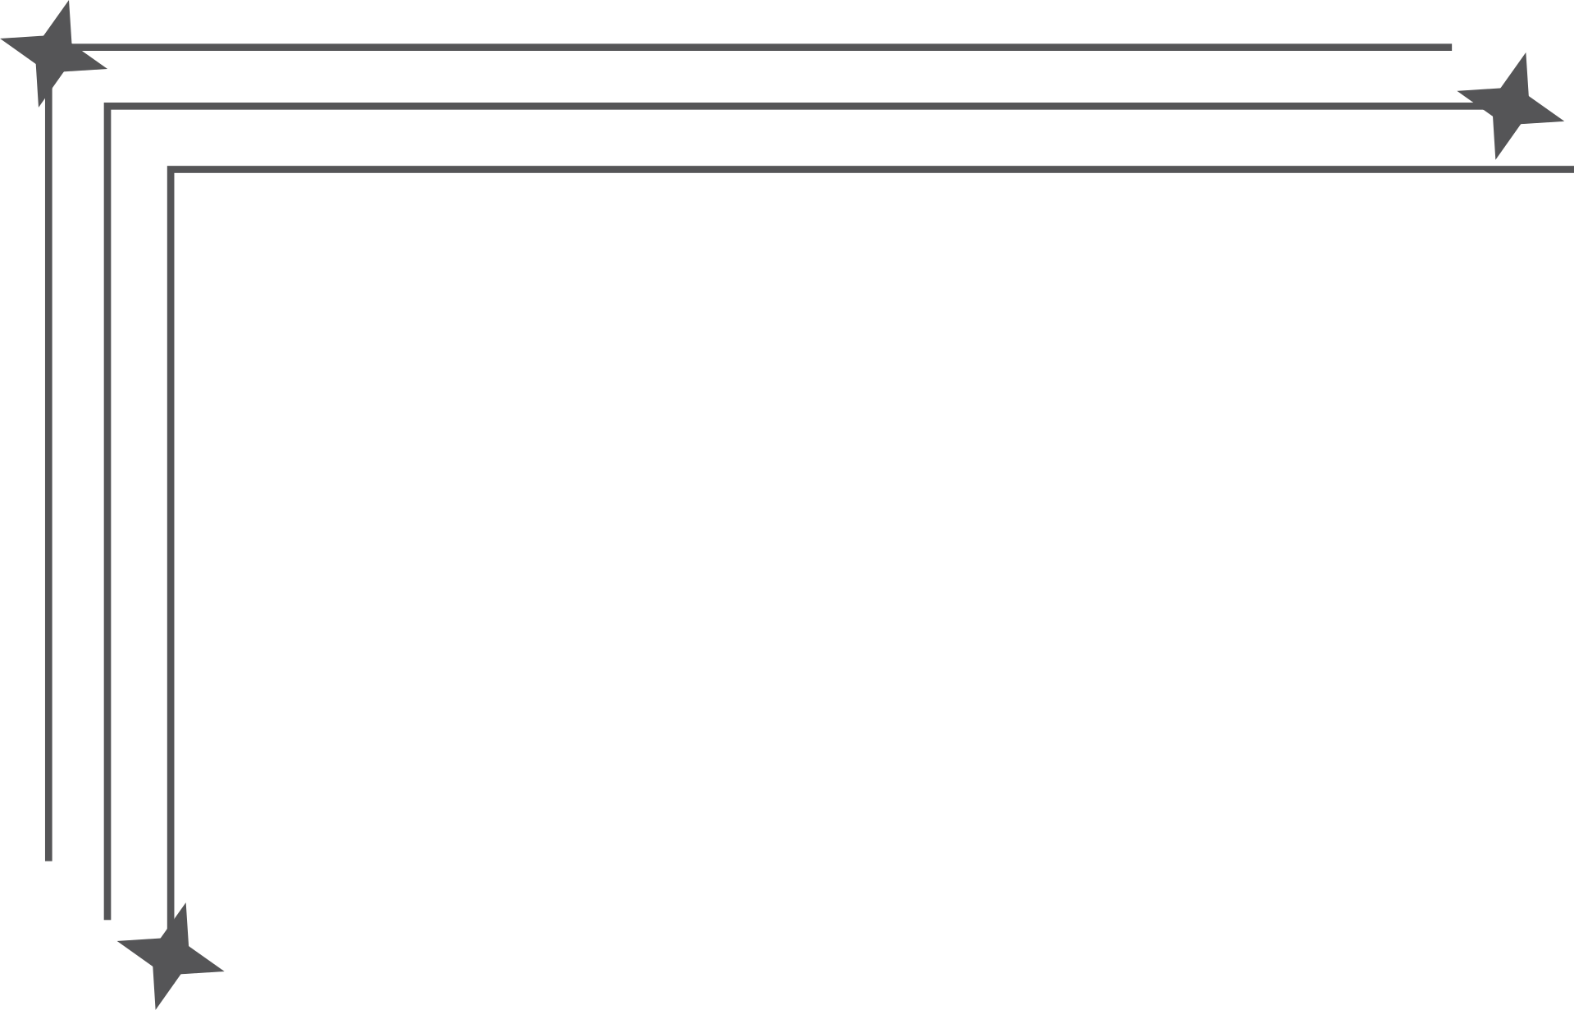

Dayananda Sagar Academy of Technology and management
CERTRACK
More Than Just Certificate Tracking
www.certrack.com

Slide 2
Dayananda Sagar Academy of Technology and management
INTRODUCTION
In today’s education system, students collect many certificates from online courses, contests, internships and workshops, but these documents are scattered across emails, folders, cloud drives and paper, making them hard to find when needed for placements or scholarships.​
CerTrack is a web-based Certificate Tracking & Educational Portal Management System with separate logins for students, teachers and administrators, where students can store and categorise certificates, build resumes, explore competitions and submit leave requests, while staff can review requests and view achievements.

Slide 3
Dayananda Sagar Academy of Technology and management
PROBLEM STATEMENT
currently, when a student applies for placement or an internship, they waste 2-3 hours searching for scattered certificates across emails and downloads.
Teachers spend days approving leave requests manually.
Students often forget most achievements completely because there is no single place that reminds them what they have done over 3–4 years, so many good certificates never reach their resume or placement file.​

Slide 4
Dayananda Sagar Academy of Technology and management
Different companies and internships ask for different formats of resumes and proof, so students repeatedly retype the same details in new formats, increasing errors and inconsistencies in their applications.​
There is no link between events and academics: leave approvals, event participation and certificate submission all happen in separate channels (paper, email, WhatsApp), so tracking which student attended which event for how many days becomes almost impossible.​
Departments cannot analyze trends like which domains students are strong in, which platforms they use most, or how achievements grow year by year, because data is not collected in a structured, centralized system.

Slide 5

Dayananda Sagar Academy of Technology and management
BACKGROUND / LITERATURE REVIEW
Many students now complete MOOCs, coding contests and internships on platforms like Coursera, NPTEL, HackerRank etc., which issue digital certificates but do not provide a unified way to manage them across platforms.​
Common tools such as email, Google Drive, spreadsheets or ERP/LMS systems either focus only on storage or only on internal academics, and do not combine certificate organisation, event tracking and resume generation in a single student‑centric portal.​

Slide 6
Dayananda Sagar Academy of Technology and management
BACKGROUND / LITERATURE REVIEW
Research and existing academic portals mainly address user management and basic achievement logging, but they lack features like integrated leave workflows, external competition discovery, and automatic reuse of certificate data for resumes.​
These gaps show the need for a lightweight, web-based system that centralizes student achievements, supports multiple roles (student, teacher, admin), and follows modern web design principles like modular architecture, role-based access and responsive UI.

Slide 7
Dayananda Sagar Academy of Technology and management
METHODOLOGY
Requirement Analysis:
Identified problems faced by students, teachers and admins in managing certificates, leave requests and resumes.
Listed core features: certificate storage, course/contest discovery, leave workflow, resume builder, role-based access.​
Frontend Implementation:
Developed all pages using HTML5 for structure, CSS3 (Flexbox, Grid) for responsive layouts, and JavaScript ES6+ for form validation, data handling and role-based logic.​
Organized code into multiple JS files (app.js, student-portal.js, teacher-portal.js, admin-portal.js) to keep features modular and maintainable.

Slide 8
Dayananda Sagar Academy of Technology and management
ANALYSIS AND DESIGN
Architecture: CerTrack is a browser-based multi-role web app with HTML5 for structure, CSS3 for responsive layout and JavaScript for all application logic, using localStorage for Phase‑1 data storage.
Roles and Portals: Separate portals exist for Student, Teacher and Admin, each with its own HTML page and JS file, implementing clear role-based access to features like certificates, leave requests, verification and user management.
Data Design: Core entities (User, Certificate, LeaveRequest, Course/Contest) are stored as structured JSON objects in localStorage, designed so they can later be mapped directly to database tables in a backend.
UI/UX: The system uses dashboard-style layouts with tabs/cards, clean typography and Flexbox/Grid-based responsive design to keep the interface simple and usable on desktop and mobile devices.

Slide 9
Dayananda Sagar Academy of Technology and management
IMPLEMENTATION
Frontend Stack - HTML5, CSS3 (Flexbox/Grid), JavaScript ES6+
Modular Code Structure - Separate files for each portal (student, teacher, admin)
Core Features Built - Certificate management, Resume builder, Leave system, Course discovery
Data Handling - How localStorage stores/retrieves data
UI/UX Implementation - Tab switching, card-based lists, form validation
Testing & Quality - Browser compatibility, responsive design, form validation

Slide 10
Dayananda Sagar Academy of Technology and management
TESTING
Login Testing:
Entered valid student, teacher and admin credentials and verified correct redirection to respective portals.
Tested invalid email/password combinations and empty fields to ensure proper error messages and denied access.​
Add Certificate Testing:
Clicked “Add Certificate”, entered name, organization and link, then checked that a new card appears in “My Certificates” and is stored in localStorage.
Tried missing fields and repeated additions to confirm list updates correctly and delete buttons remove only the selected certificate.​

Slide 11
Dayananda Sagar Academy of Technology and management
Apply Leave Testing:
Opened “My Requests”, created a new leave request with event name, type and date range, and verified it appears in the student list and in the global teacher request list.
Left required fields empty and checked that the system shows alerts and does not create a request.​
Generate Resume Testing:
Filled profile and resume form fields, clicked “Generate Resume” and verified the preview shows correct name, contact, education, skills, projects and summary.
Tested “Copy to Clipboard” and “Download as .txt” to ensure the same content is copied/downloaded without truncation or formatting issues.​

Slide 12
Dayananda Sagar Academy of Technology and management
CONCLUSION
CerTrack is more than just a web application it's a bridge connecting what students achieve with what the world needs to see.
Every student knows the struggle: certificates scattered across emails, folders, and forgotten downloads. Teachers drowning in paper based leave approvals. Resumes built piece by piece, losing critical information along the way. And institutions left wondering about the real capabilities of their students.
CerTrack changes this story.
By bringing everything into one seamless platform, we're not just organizing data we're empowering students to own their journey. We're giving teachers back their time to focus on what matters: mentoring and teaching. We're helping institutions make smarter decisions based on real, verified student achievements.

Slide 13
Dayananda Sagar Academy of Technology and management
FUTURE SCOPE
CerTrack can evolve into a common platform used across multiple institutes, where all student achievements and leave details are visible in one trusted system for teachers, departments, and placement cells.​
For students, it can act as a lifelong academic identity, keeping every certificate and activity organized and ready for any opportunity without extra effort.
The workflow can become more dynamic with smarter reminders, adaptive resume templates, and dashboards that show strengths, gaps, and suggested next steps.
A key future enhancement is integrating the teacher portal with WhatsApp, so a teacher can simply send a student’s USN to a bot and instantly see that student’s details in chat—no logins, no delay.

Slide 14
Dayananda Sagar Academy of Technology and management
THANK YOU

